Slide 1
Grainger Hall Dining Expansion and Renovation Draft Environmental Impact Assessment Public Meeting – March 31, 2025
UW Project # A-24-004

Slide 2
Agenda
Introduction
WEPA Process
Project Description
Project Impacts
Public Comment Period
Closing Comments

Slide 3
Introduction
Welcome
Meeting attendance and transcription recorded in Microsoft Teams
Public Notice published in Wisconsin State Journal on March 17, 2025
Draft EIA report and comment form made available at www.ayresprojectinfo.com
Public comments will be considered during development of Final EIA

Slide 4
WEPA Process
WEPA – 1971 and UW Board of Regents Resolutions (1981, 1999)
Purpose – Evaluate environmental effects of project
Major steps in process
UWSA determines need for EIA (Type II Action)
Prepare Draft EIA report (Released March 17, 2025)
Draft EIA comment period (March 17– April 1, 2025)
Draft EIA public meeting (March 31, 2025)
Prepare Final EIA Report (early-April)
UW-Madison WEPA Coordinator – Finding of No Significant Impact or Recommendation for Environmental Impact Statement

Slide 5
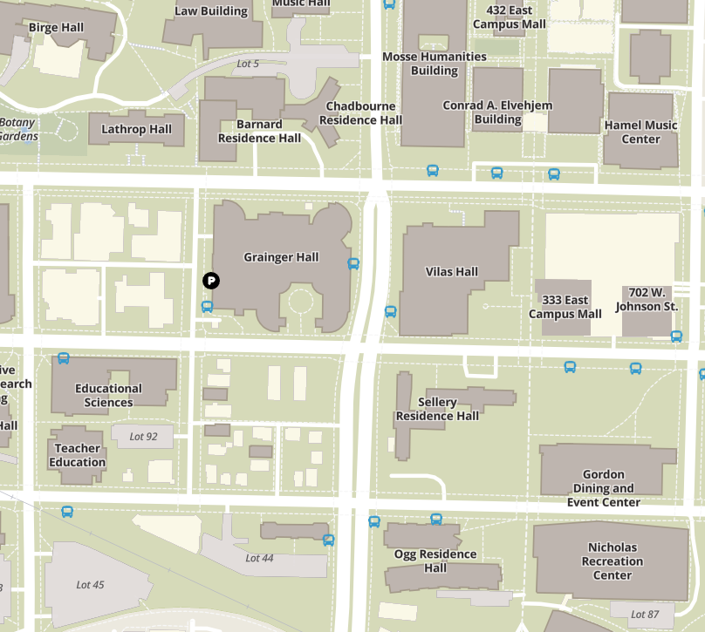
Project Description
Background
Grainger Hall (Wisconsin School of Business)
Purpose and Need
Shortage of dining and study spaces
Modernization, sustainability and accessibility improvements
Notes:
Introduction: Grainger Hall, home to the Wisconsin School of Business, serves as a hub for students, faculty, and business leaders. The proposed expansion and renovation address the growing demand for dining and study spaces.
Purpose and Need: The project not only enhances dining and student engagement areas but also modernizes the facility by incorporating sustainability and accessibility improvements that align with UW-Madison’s long-term goals.

Slide 6
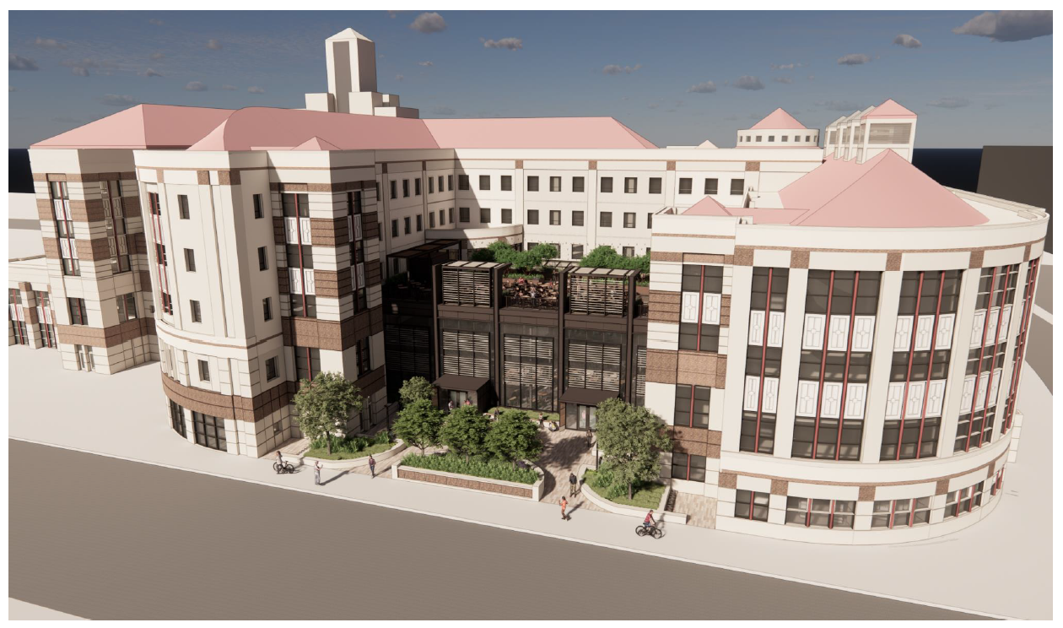
Project Description
The South Courtyard will be transformed with the addition of the 8,200-square-foot Winter Garden and roof top terrace.
The new Winter Garden will feature ample natural light, shaded gathering areas, and enhanced accessibility.
South Courtyard by Workshop Architects, Inc.
Notes:
Winter Garden: The 8,200-square-foot Winter Garden will provide a versatile, enclosed courtyard with natural daylight, shaded gathering areas, and improved accessibility, creating an inviting space for year-round student use.
Rooftop Terrace: The 6,300-square-foot rooftop terrace will feature outdoor seating, food kiosks, and green space, for dining and collaboration. The terrace will incorporate shading systems and permeable pavers to enhance stormwater management.

Slide 7
Project Description
North Plaza by Workshop Architects, Inc.
Notes:
The North Plaza enhancements along University Avenue will focus on improving landscaping and increasing bike parking capacity to better serve students, faculty, and visitors.
Landscaping: Addition of native plantings, shrubs, and ornamental grasses to improve aesthetics and stormwater management.
Bike Parking: Expansion of bike parking spaces to encourage alternative transportation and improve the flow of pedestrian traffic.

Slide 8
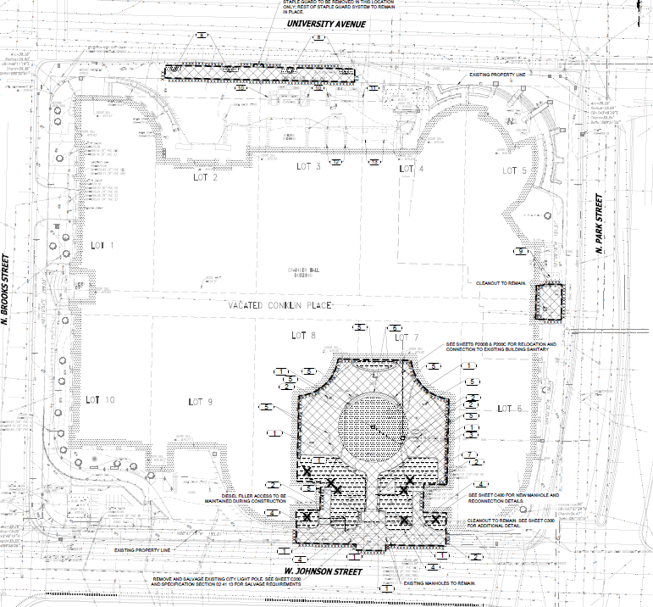
Project Description
To facilitate the expansion, portions of the south and north courtyards will be modified, requiring the removal of:
8 trees in the south courtyard.
Existing paved walkways and landscaping.
“Water Links II” by Athena Tacha, located on the first floor of Grainger Hall.
Demolition plan by Workshop Architects, Inc.
Notes:
Portions of the south and north courtyards will be modified to accommodate the new additions. This includes the removal of 8 trees, landscaping, and existing paved walkways.
Water Links II: The project also involves the removal of ‘Water Links II,’ an artistic water feature, located on the first floor of Grainger Hall. The artist has been notified and efforts are being made to recognize the work.

Slide 9
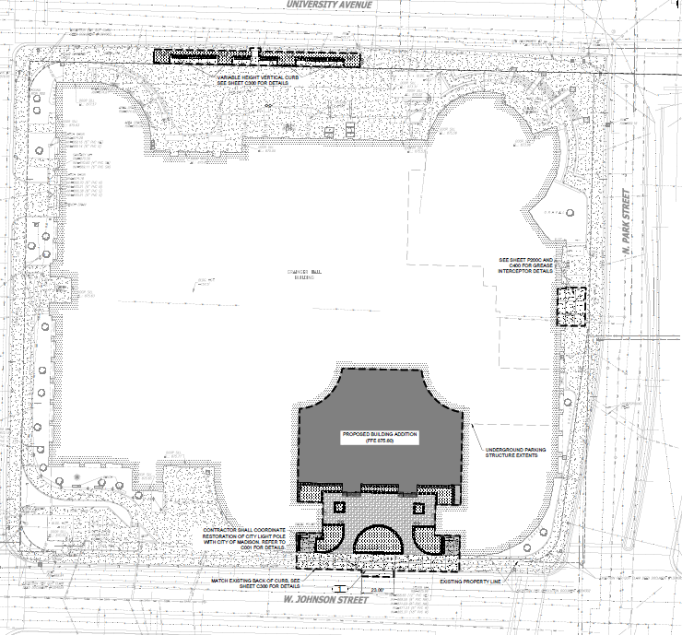
Project Description
Winter Garden Addition: 8,200-square-foot enclosed space in the South Courtyard.
Rooftop Terrace: 6,300-square-foot outdoor seating area with food kiosks and landscaping.
North Plaza Improvements: Redesigned pedestrian circulation, seating areas, and enhanced landscaping.
South Courtyard Modifications: Removal of 8 trees and repurposing of courtyard space for the Winter Garden.
Site plan by Workshop Architects, Inc.
Notes:
This site plan provides an overview of the proposed additions, including the Winter Garden in the south courtyard and the rooftop terrace.

Slide 10
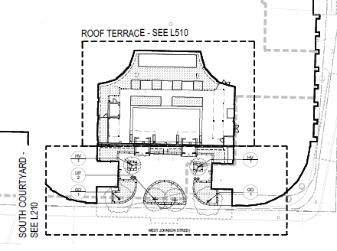
Project Description
The south courtyard landscape plan introduces sustainable design elements, including:
Permeable pavers to enhance stormwater management.
New vegetation to replace removed trees.
The rooftop terrace will include a mix of ornamental trees, shrubs, and grasses.
Landscaping plan by Workshop Architects, Inc.
Notes:
The landscape plan for the South Courtyard and rooftop terrace incorporates sustainable design features such as permeable pavers to improve stormwater management and reduce runoff. New plantings, including deciduous trees, shrubs, and ornamental grasses, will replace removed trees.

Slide 11
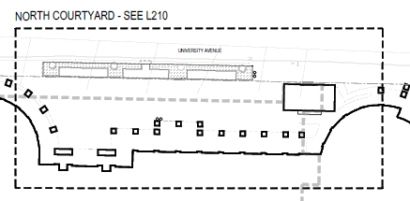
Project Description
The north plaza landscaping plan maintains existing trees.
New plantings will include deciduous trees, shrubs to complement the plaza improvements.
Landscaping plan by Workshop Architects, Inc.
Notes:
The North Courtyard landscape plan retains existing trees and introduces new shrubs.

Slide 12
Project Description
Project Schedule
Begin construction: June 2025
Substantial completion: July 2026
Project Budget
The total project budget is $27,140,000.
Gift and grant funds will cover the total project cost.
Notes:
The project is scheduled to begin construction in June 2025, with substantial completion expected by July 2026, ensuring minimal disruption to campus operations. The total project budget is $27.14 million, fully funded through gift and grant funds.

Slide 13
Project Impacts
Physical
Short-term noise, vibrations, soil disturbance, and dust during construction
Temporary traffic disruptions and pedestrian detours.
Biological
No impacts on threatened or endangered species.
Landscaping enhancements will introduce new vegetation and improve stormwater management.
Socioeconomic
Expanded dining and engagement spaces will enhance the student experience.
Approximately 12 full-time positions will be added to support the expanded dining operations.
Estimated $3.5 million annual revenue increase due to expanded food service offerings.
Estimated 227 jobs supported during construction, with an economic impact of $34.8 million.

Slide 14
Project Impacts
Archaeological and Historical
Grainger Hall was built in 1991 and is listed in the Architecture and History Inventory (AHI) but is not eligible for the National Register of Historic Places (NRHP).
No documented archaeological resources are present within the project area.
Hazardous Materials
While Grainger Hall was built after the ban on lead-based paint, there is still a potential for asbestos-containing materials (ACM) in certain building materials.
An asbestos inspection and, if necessary, abatement will be conducted before renovation activities in accordance with NR 447 and EPA regulations.
Three underground storage tanks (USTs) were removed in 1991 during the construction of Grainger Hall. One of the USTs leaked resulting in WDNR LUST case (#03-13-001105), which was closed after 30 tons of contaminated soil was excavated and removed from the site.
Contaminated soil is not expected to be encountered during construction.

Slide 15
Alternatives
No Action
Inadequate seating and dining capacity would continue to create congestion during peak hours.
Outdoor courtyard spaces would remain underutilized during colder months.
The opportunity to provide modern, climate-controlled spaces for student engagement and study would be missed.
Does not meet UW-Madison’s needs for expanded dining, study, and engagement spaces
Other Alternatives (new build site, relocate to another building)
Expanding another UW-Madison dining facility rather than Grainger Hall would not address the site-specific need for additional food service, study, and gathering spaces at the Wisconsin School of Business.
Developing a new standalone facility would require additional land acquisition or repurposing another site on campus, leading to higher construction costs and greater environmental disturbance.

Slide 16
Public Comment Period
15-day comment period (March 17- April 1) ends tomorrow
Please offer any comments using the form provided at www.ayresprojectinfo.com or orally during this meeting

Slide 17
Closing Comments
Public comments will be considered during development of the Final EIA
Final EIA report anticipated to be issued in the following 1-2 weeks

